Slide 1
Write your first Flutter app Part 2 https://codelabs.developers.google.com/codelabs/first-flutter-app-pt2
Notes:
I’d like to concentrate on two parts of Flutter, that I especially admire

Slide 2
Introduction
In this codelab, you'll extend a basic, mobile Flutter app to include interactivity.
You'll also create a second page (called a route) that the user can navigate to.
Finally, you'll modify the app's theme (color).
This codelab extends part 1, where you create an infinite lazily loaded list, but we'll provide the starting code, if you'd like to start with part 2.

Slide 3
What you'll learn in part 2
How to write a Flutter app that looks natural on iOS, Android, and the web
How to use hot reload for a quicker development cycle
How to add interactivity to a stateful widget
How to create and navigate to a second screen
How to change the look of an app using themes

Slide 4
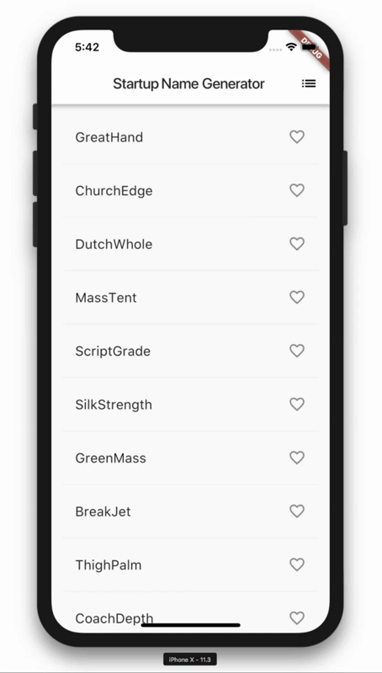
What you'll build in part 2
You'll start with a simple mobile app that generates an endless list of proposed names for a startup company.
By the end of the codelab, your end users can select and unselect names, saving the best ones.
Tapping the list icon in the upper right of the app bar navigates to a new page (called a route) that lists only the favorited names.

Slide 5
Get the Starting App
If you have worked through part 1 of this codelab, you already have the starting app, startup_namer. You can proceed to the next step.
If you don't have startup_namer, no fear, you can get it using the following instructions.

Slide 6
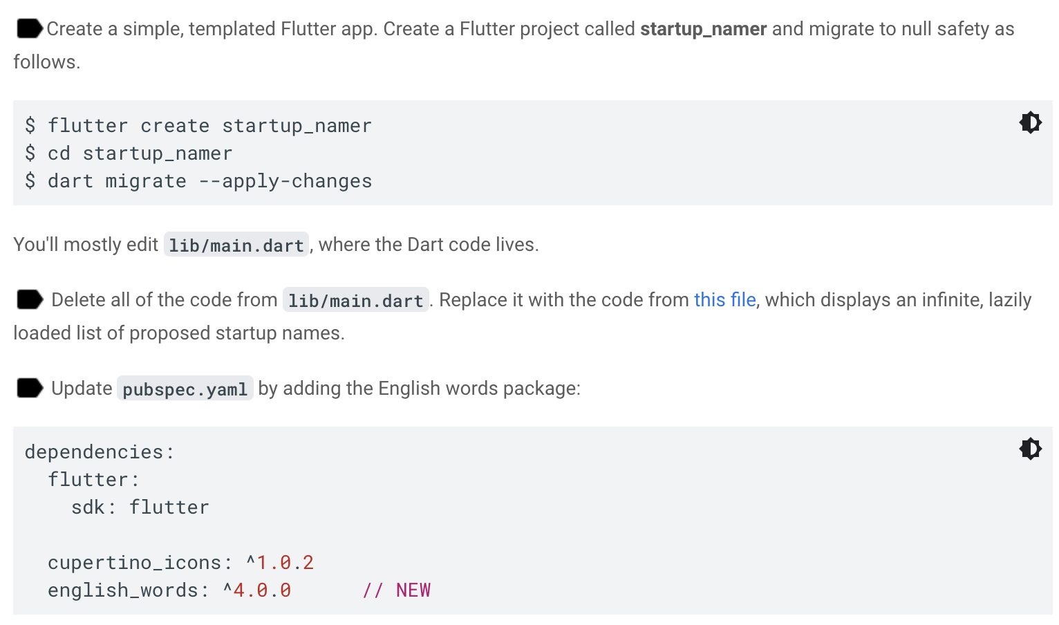

Slide 7
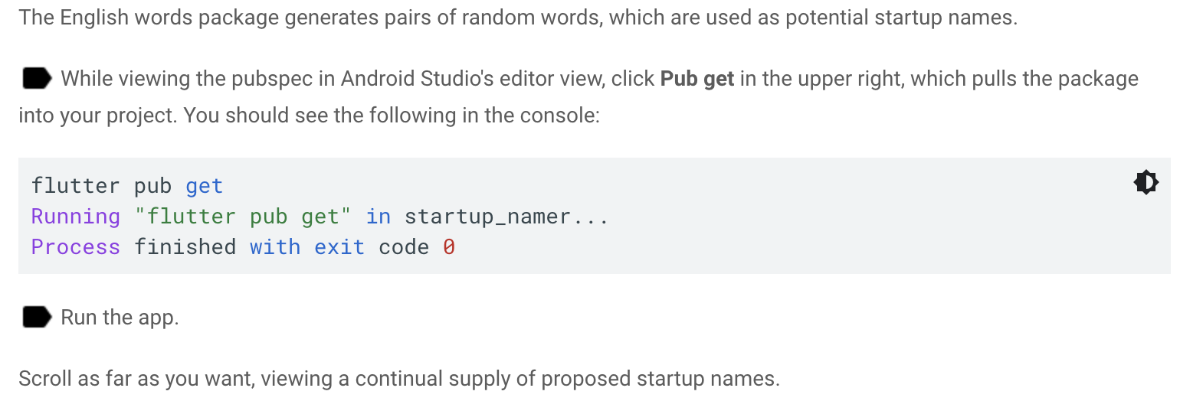

Slide 8
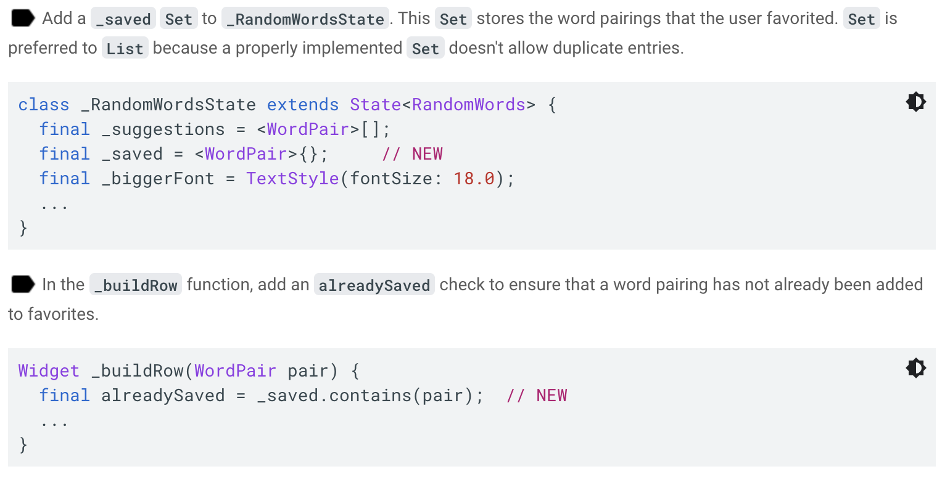
Add icons to the list
In this step, you'll add heart icons to each row. In the next step, you'll make them tappable and save the favorites.

Slide 9
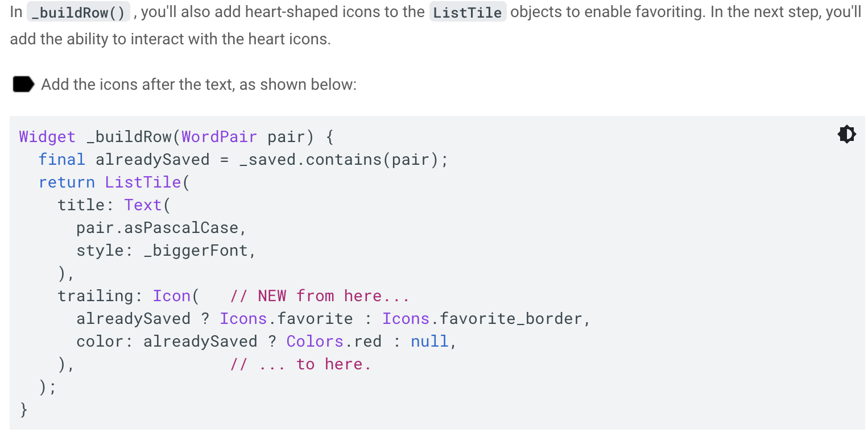

Slide 10
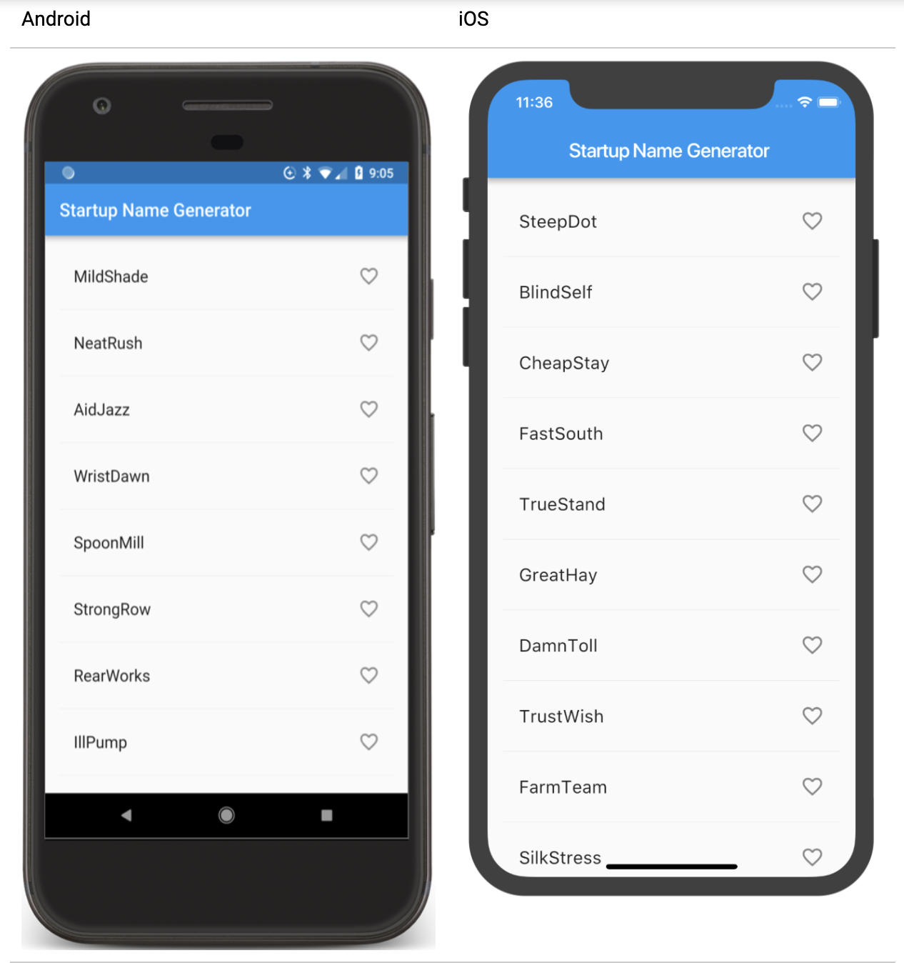
Hot reload the app.
You should now see open hearts on each row, but they are not yet interactive.

Slide 11
Problems?
If your app isn't running correctly, you can use the code at the following link to get back on track.
lib/main.dart

Slide 12
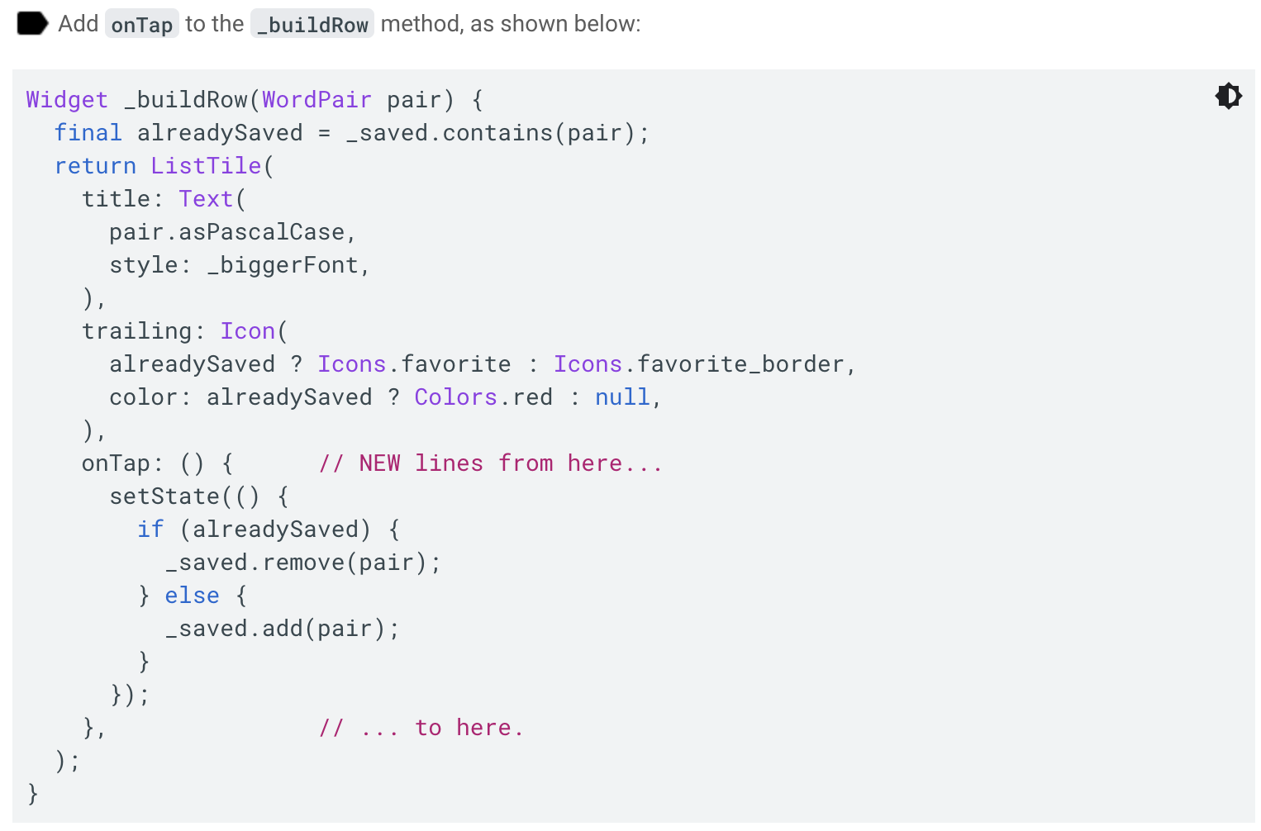
Add interactivity
In this step, you'll make the heart icons tappable.
When the user taps an entry in the list, toggling its favorited state, that word pairing is added or removed from a set of saved favorites.

Slide 13
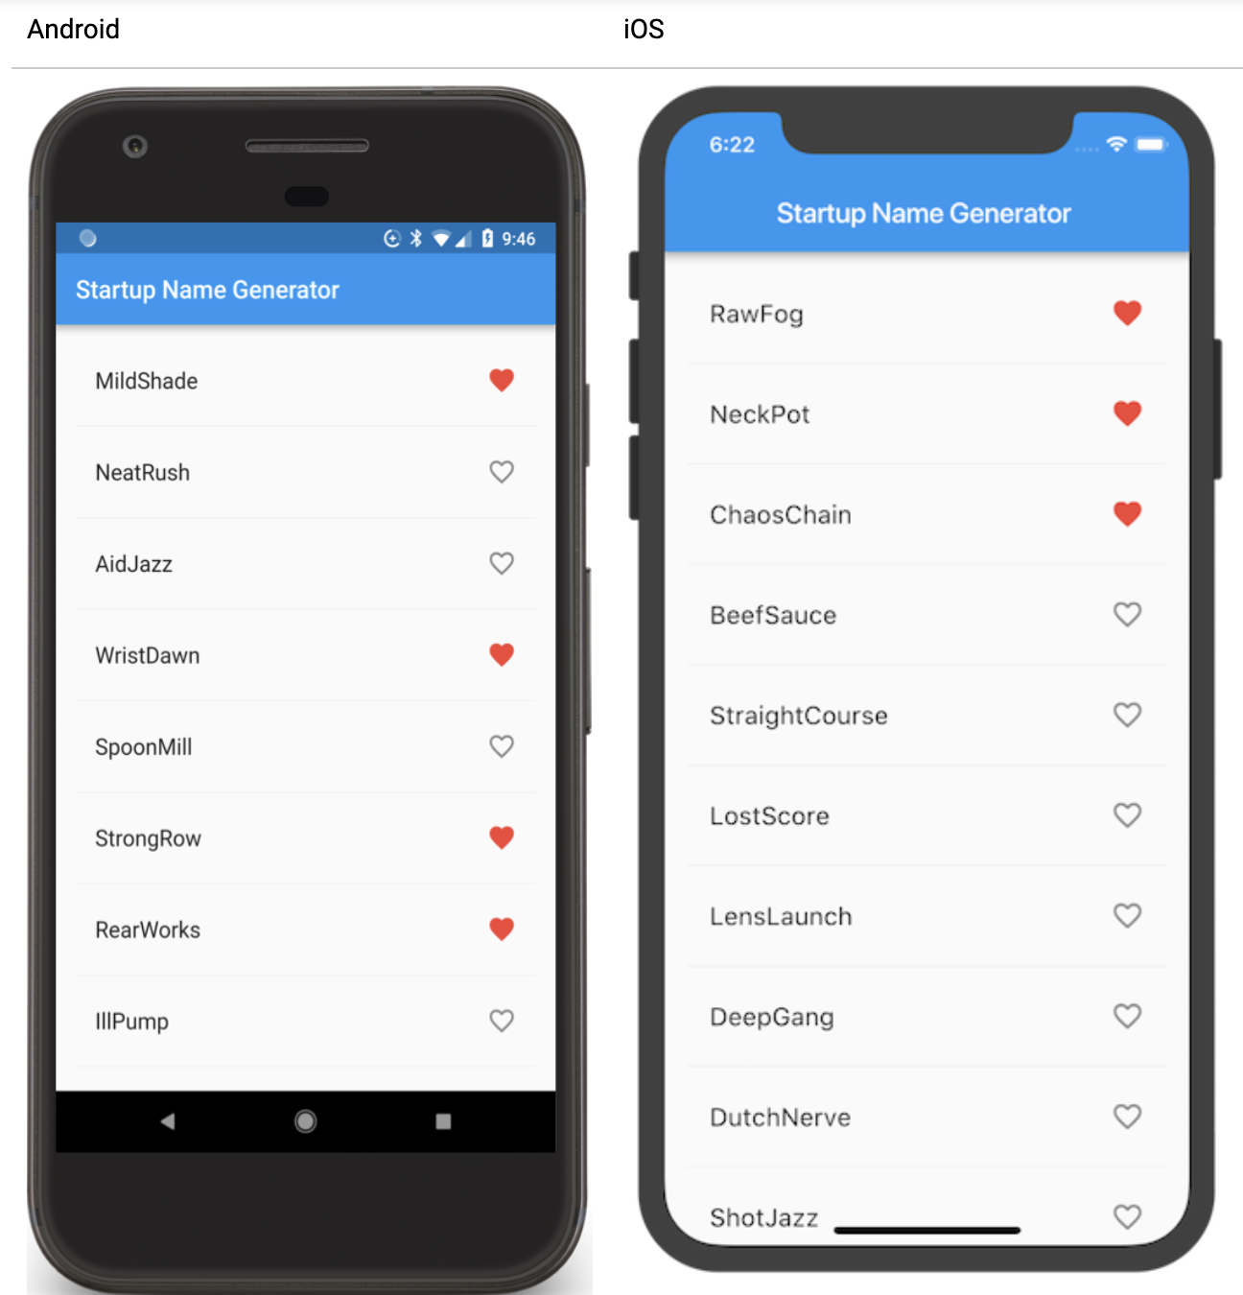
Hot reload the app.
You should be able to tap any tile to favorite or unfavorite the entry. Tapping a tile generates an implicit ink splash animation emanating from the tap point.

Slide 14
Problems?
If your app isn't running correctly, you can use the code at the following link to get back on track.
lib/main.dart

Slide 15
Navigate to a new screen
In this step, you'll add a new page (called a route in Flutter) that displays the favorites. You'll learn how to navigate between the home route and the new route.
In Flutter, the Navigator manages a stack containing the app's routes. Pushing a route onto the Navigator's stack updates the display to that route. Popping a route from the Navigator's stack returns the display to the previous route.

Slide 16
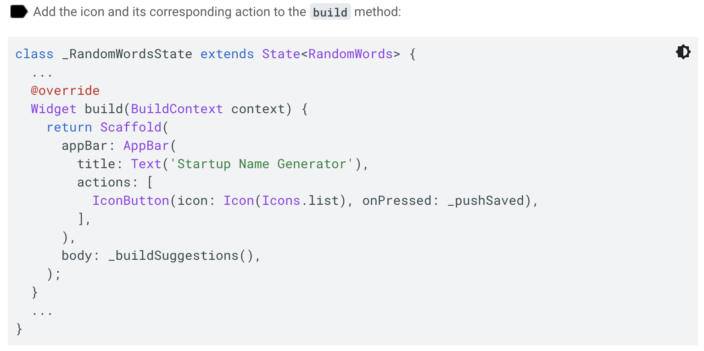

Slide 17
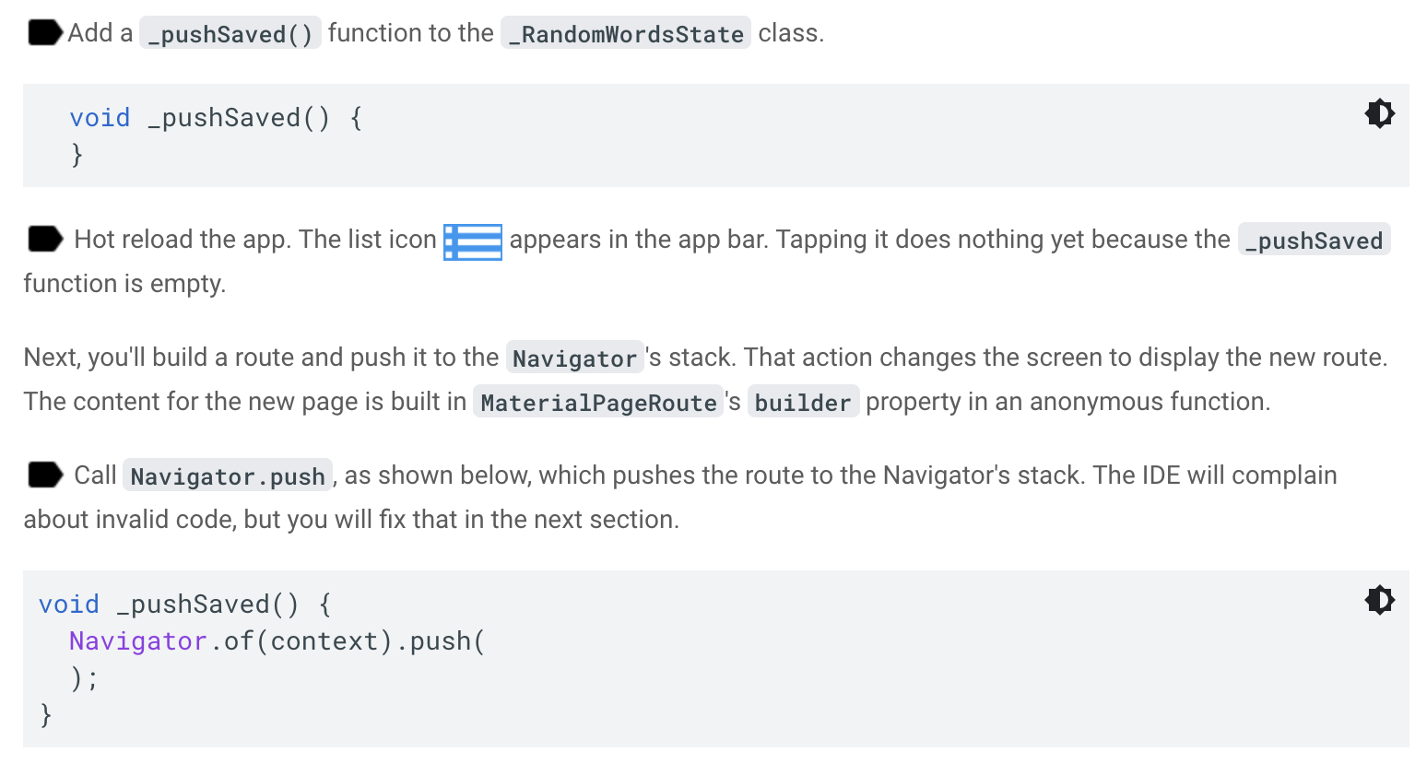

Slide 18
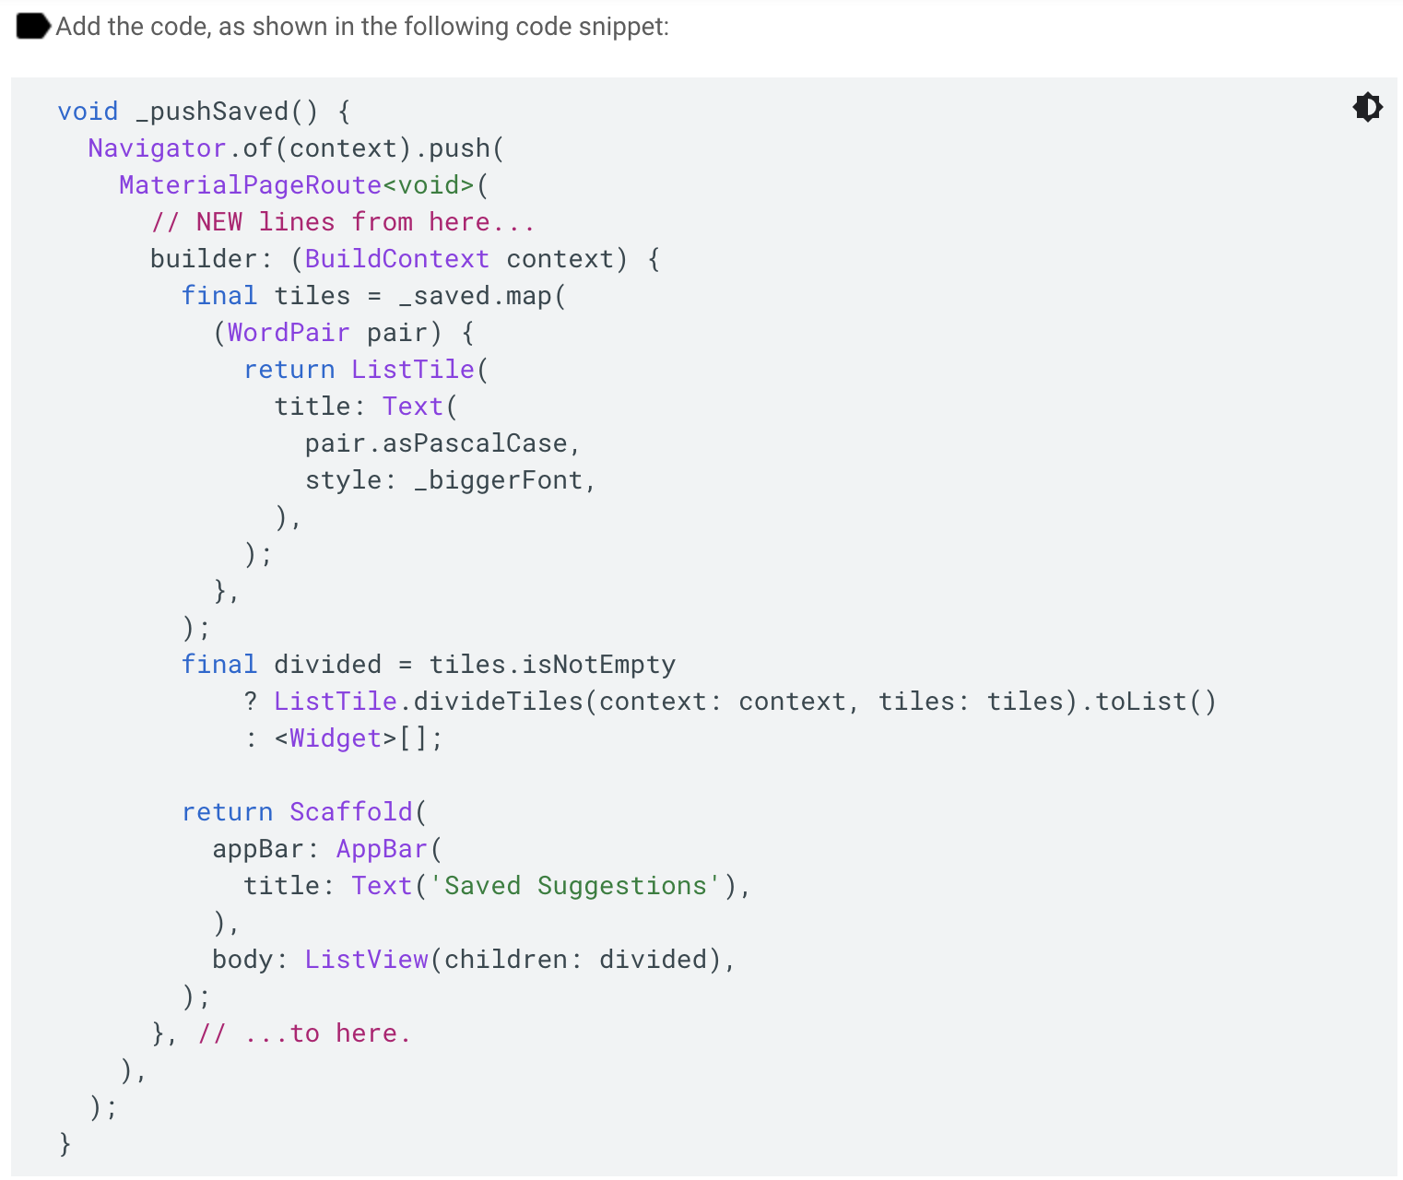
Next, you'll add the MaterialPageRoute and its builder.

Slide 19
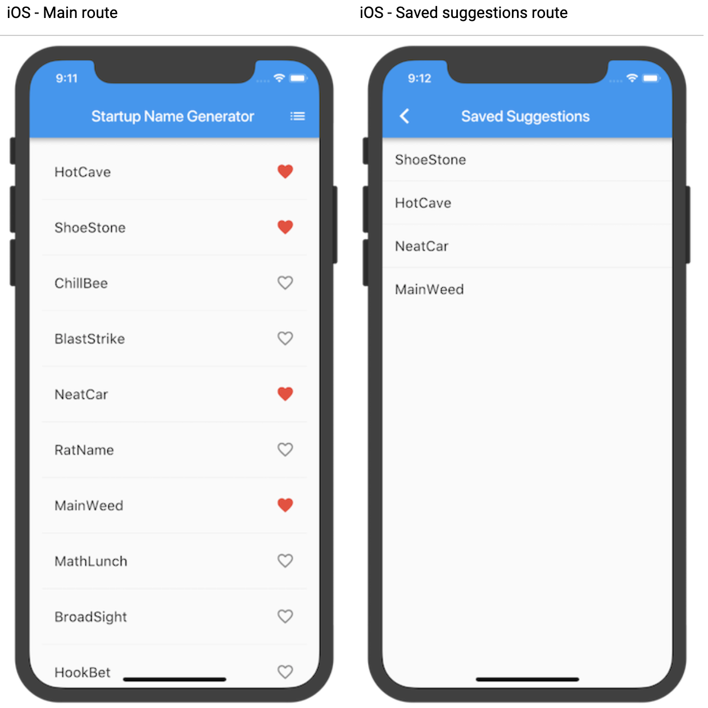
Hot reload the app.
Favorite some of the selections and tap the list icon in the app bar.
The new route appears containing the favorites.

Slide 20
Problems?
If your app isn't correctly running, then you can use the code at the following link to get back on track.
lib/main.dart

Slide 21
Change the UI using Themes
In this step, you'll modify the app's theme.
The theme controls the look and feel of your app.
You can either use the default theme, which is dependent on the physical device or emulator, or customize the theme to reflect your branding.

Slide 22
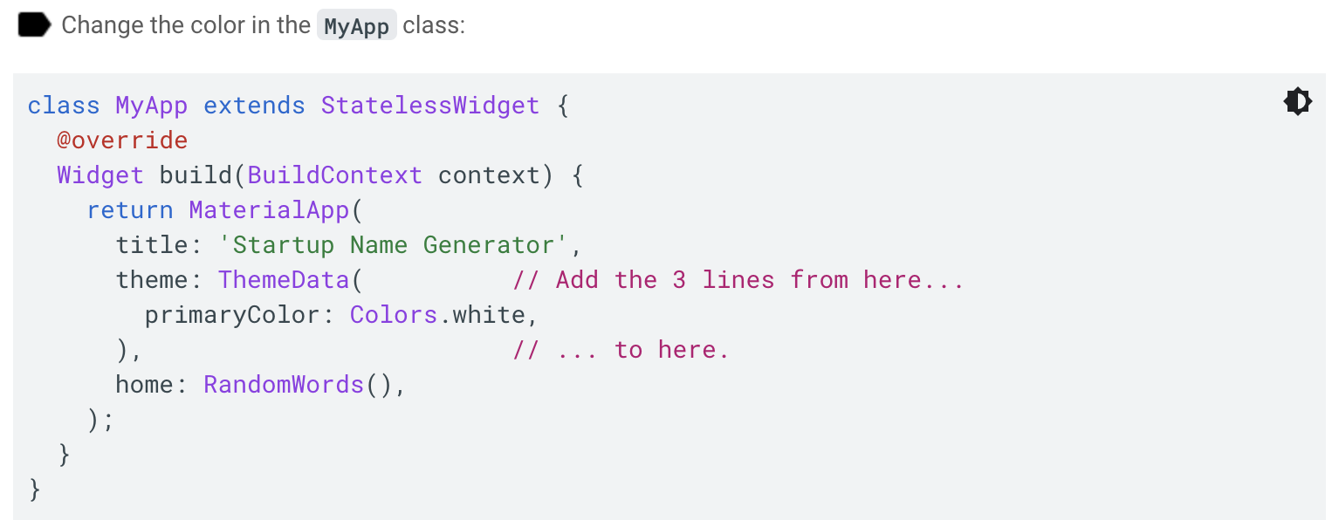

Slide 23
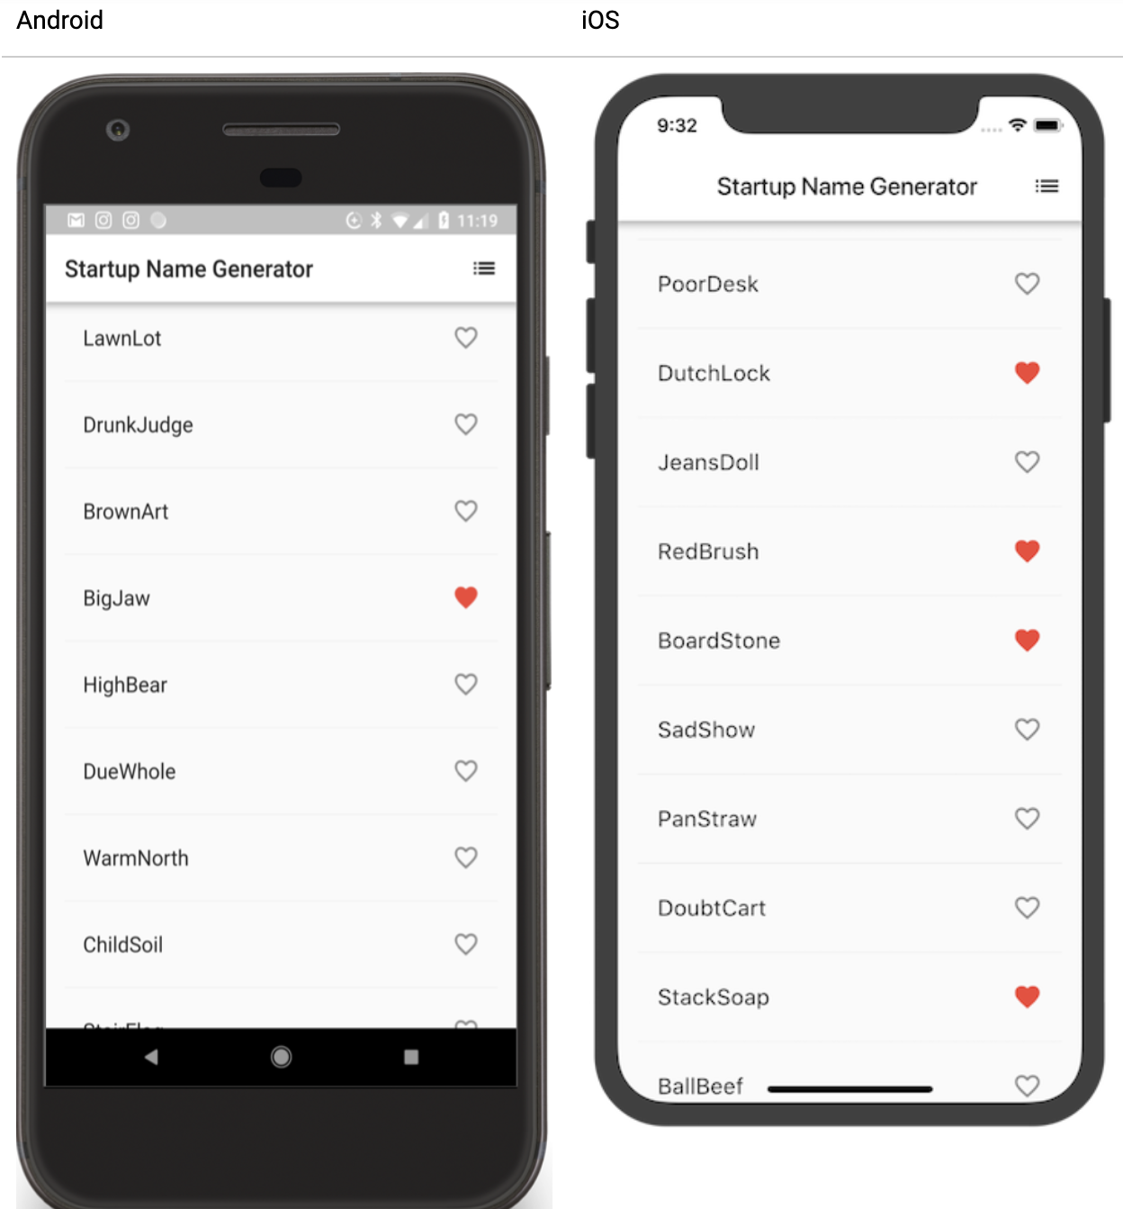
Hot reload the app.
The entire background is now white, even the app bar.

Slide 24
Problems?
If you've gotten off track, then use the code from the following link to see the code for the final app.
lib/main.dart

Slide 25
Well done!
You wrote an interactive Flutter app that runs on iOS and Android by doing the following:
Writing Dart code
Using hot reload for a faster development cycle
Implementing a stateful widget, adding interactivity to your app
Creating a route and adding logic for moving between the home route and the new route
Learning about changing the look of your app's UI using themes

Slide 26
Next steps
Learn more about the Flutter SDK from the following resources:
Layouts in Flutter
Add interactivity to your Flutter app
Introduction to widgets
Flutter for Android developers
Flutter for React Native developers
Flutter for web developers
Flutter's YouTube channel

Slide 27
Other resources include:
Cookbook
Bootstrap into Dart
Also,
connect with the Flutter community!

Slide 28
Thank you!
Wenxuan Shi
College of Software, Nankai University
Email: shiwx@nankai.edu.cn
Wechat: 13920561100

